Slide 1


Slide 2
Fracture Liaison Services
Benefits of the ANZFFR Long-Term Care Plan

Slide 3
Fracture Liaison Services
The Magic Benefits of the ANZFFR Long-Term Care Plan!

Slide 4
Fracture Liaison Services
The Magic of the ANZFFR Long-Term Care Plan
Pushing Shit Uphill (with a fork)!!!!

Slide 5
“Benefits of the Long-Term Care Plan”
Case Study
Q and A
LTCP
Q and A
Discussion
KPI 12
Discussion
Standard 5
Future questions/Food for thought

Slide 6
Case Study
EG
Male, 58 years
Anaesthetic technician
Referred to FLS from GP
L2 fracture lifting sheet of roofing iron-immediate back pain, NO fall 8/6/24
Physio etc. but ongoing pain. X-ray 12/11/24- Stable “mild’ compression # L2
Extensive PMH-
Kidney donor-“altruistic” (eGFR 65-79)
Gastric bypass bariatric surgery (Roux-en-Y)2012 (130kg-82kg)=Malabsorption risk-Rx’d Ca2+ “lifelong”, not taking now
Multiple previous #’s inc, pelvis 2016, distal radius 2021-trauma related
Sertoli Cell Only Syndrome (infertility);Depression (ongoing Rx);TURP 2019; Sl elevated HbA1c
LONG distance cycling (300km+!)
Rx Losartan, Sertraline, Nortriptyline, Fe, Vit C, Centrum
Vit D Normal (88 2024)
DXA 2016 F-U for bariatric surgery “accelerated bone loss in upper femora”
DXA 2025-ordered by FLS

Slide 7
DXA Result 25/3/2025
Bone Mineral Analysis Spine L1-L4: BMD 0.975 g/cm2 T Score -2.0* Z Score -1.7
Right Femoral Neck: BMD 0.852 g/cm2 T Score -1.7* Z Score -0.8
Dual Total Femur: BMD 0.915 g/cm2 T Score -1.3* Z Score -0.8
Osteoporosis Grade (WHO): Marked osteopenia.
10 Year Major Fracture Risk (FRAX UK): 4.8%*
10 Year Hip Fracture Risk (FRAX UK): 0.8%.*
Follow Up Last Scan: 24/6/2016 Change in BMD: 0.094 g/cm2. Significant.
Summary: Marked osteopenia in the lumbar spine with moderate osteopenia in the right femoral neck.
Since the previous scan in 2016 there has been accelerated loss of spinal and upper femoral BMD.
Recommendation If there is any clinical concern regarding vitamin D status, supplementation should be considered. A follow-up scan in 4 to 5 years is recommended.*
Dr JF FRANZCR, Radiologist Auckland Radiology-Bay Radiology-Pacific Radiology*

Slide 8
Question Time
Q1 –Do you use the Long-Term Care Plan?
Q2 –Do you use another letter?
Q3 –How do you deliver that letter?
-Electronic/ “Direct to GP”?
-Email?
-Post?
-Other? (e.g. pigeon etc.)
Q4 –Do you copy the letter to the patient?

Slide 9
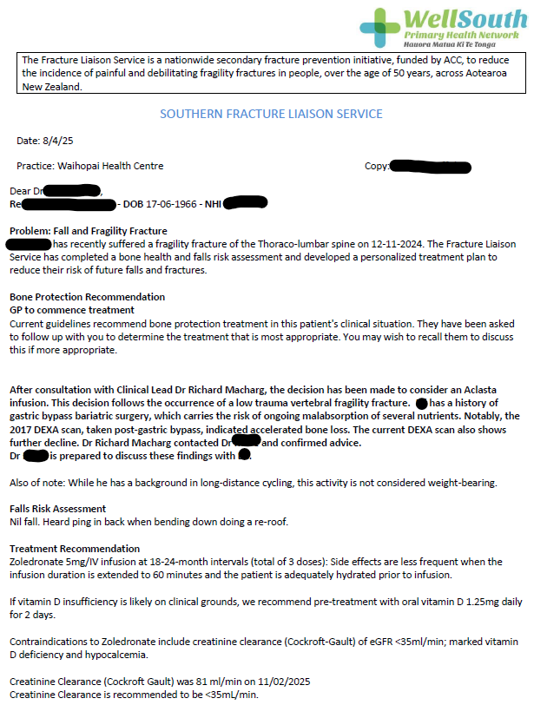
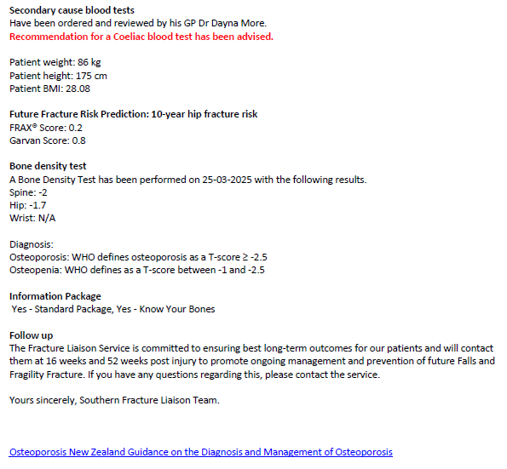

Slide 10
Question Time 2
Q5 –Does your FLS accept referrals from general practice/primary care?
-Electronic?
-Other? (e.g. phone, snail?,…pigeon??)
Q6 –Does you FLS area have a Shared Electronic Health Record?
Q7 –Does you FLS post reports on the Electronic Health Record?
Q8 –Does you FLS area have Health Pathways?
Q9 –Does your FLS appear specifically on Health Pathways?
Q9 –Does your FLS issue DXA reports?

Slide 11
KPI :12
Numerator
The people who received a long-term care plan developed by the FLS, in collaboration with the person and their general practitioner , within 12 weeks of the sentinel fracture
Denominator
The total number of fracture patients identified
ANZFFR report 2025 “NZ Avg 23-24”- 65%
Currently (ytd) -58% “Delivered” 90%
???

Slide 12
Discussion: What is a ”joined-up FLS”?
Information In and Out
Universal standard and access
Advises current best practice
Individualised advice (as far as possible/practical)
Most valued and reliable source
Full visibility in secondary and primary care
Patient value (engagement?/involvement??)
Contributes to long-term care (>1 year from sentinel fracture)
The joined up FLS
Information In AND Out
Universal standard AND access
Advises current best practice
Individualised advice
Full visibility in secondary AND primary care
Patient VALUE
Most valued and reliable source
Contributes to long-term care (>1 year from sentinel fracture)

Slide 13
Standard 5 (of the “5IQ”)
:Integration
The FLS, in partnership with the person with the fracture and their general practitioner; develops a long-term care plan to reduce the risk of falls and fractures and promote long-term management.
KPI 12:Provision of long-term care plan within 12 weeks
And
KPI 13: People taking osteoporosis specific treatment 52 weeks after fracture

Slide 14
Future Questions (DON’T answer now!)
Is KPI 13 the “king of KPIs”?
Does FLS advice “Trump” DXA report?
Are we using the Long-Term Care Plan?
-Are we a fully joined-up FLS?

Slide 15
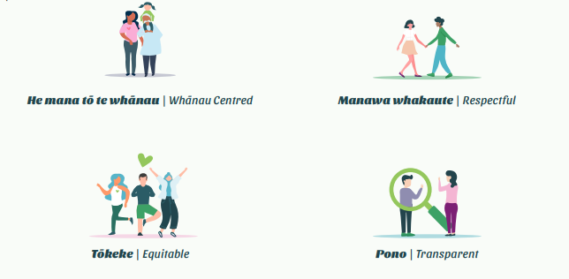
Our Values:

